Slide 1
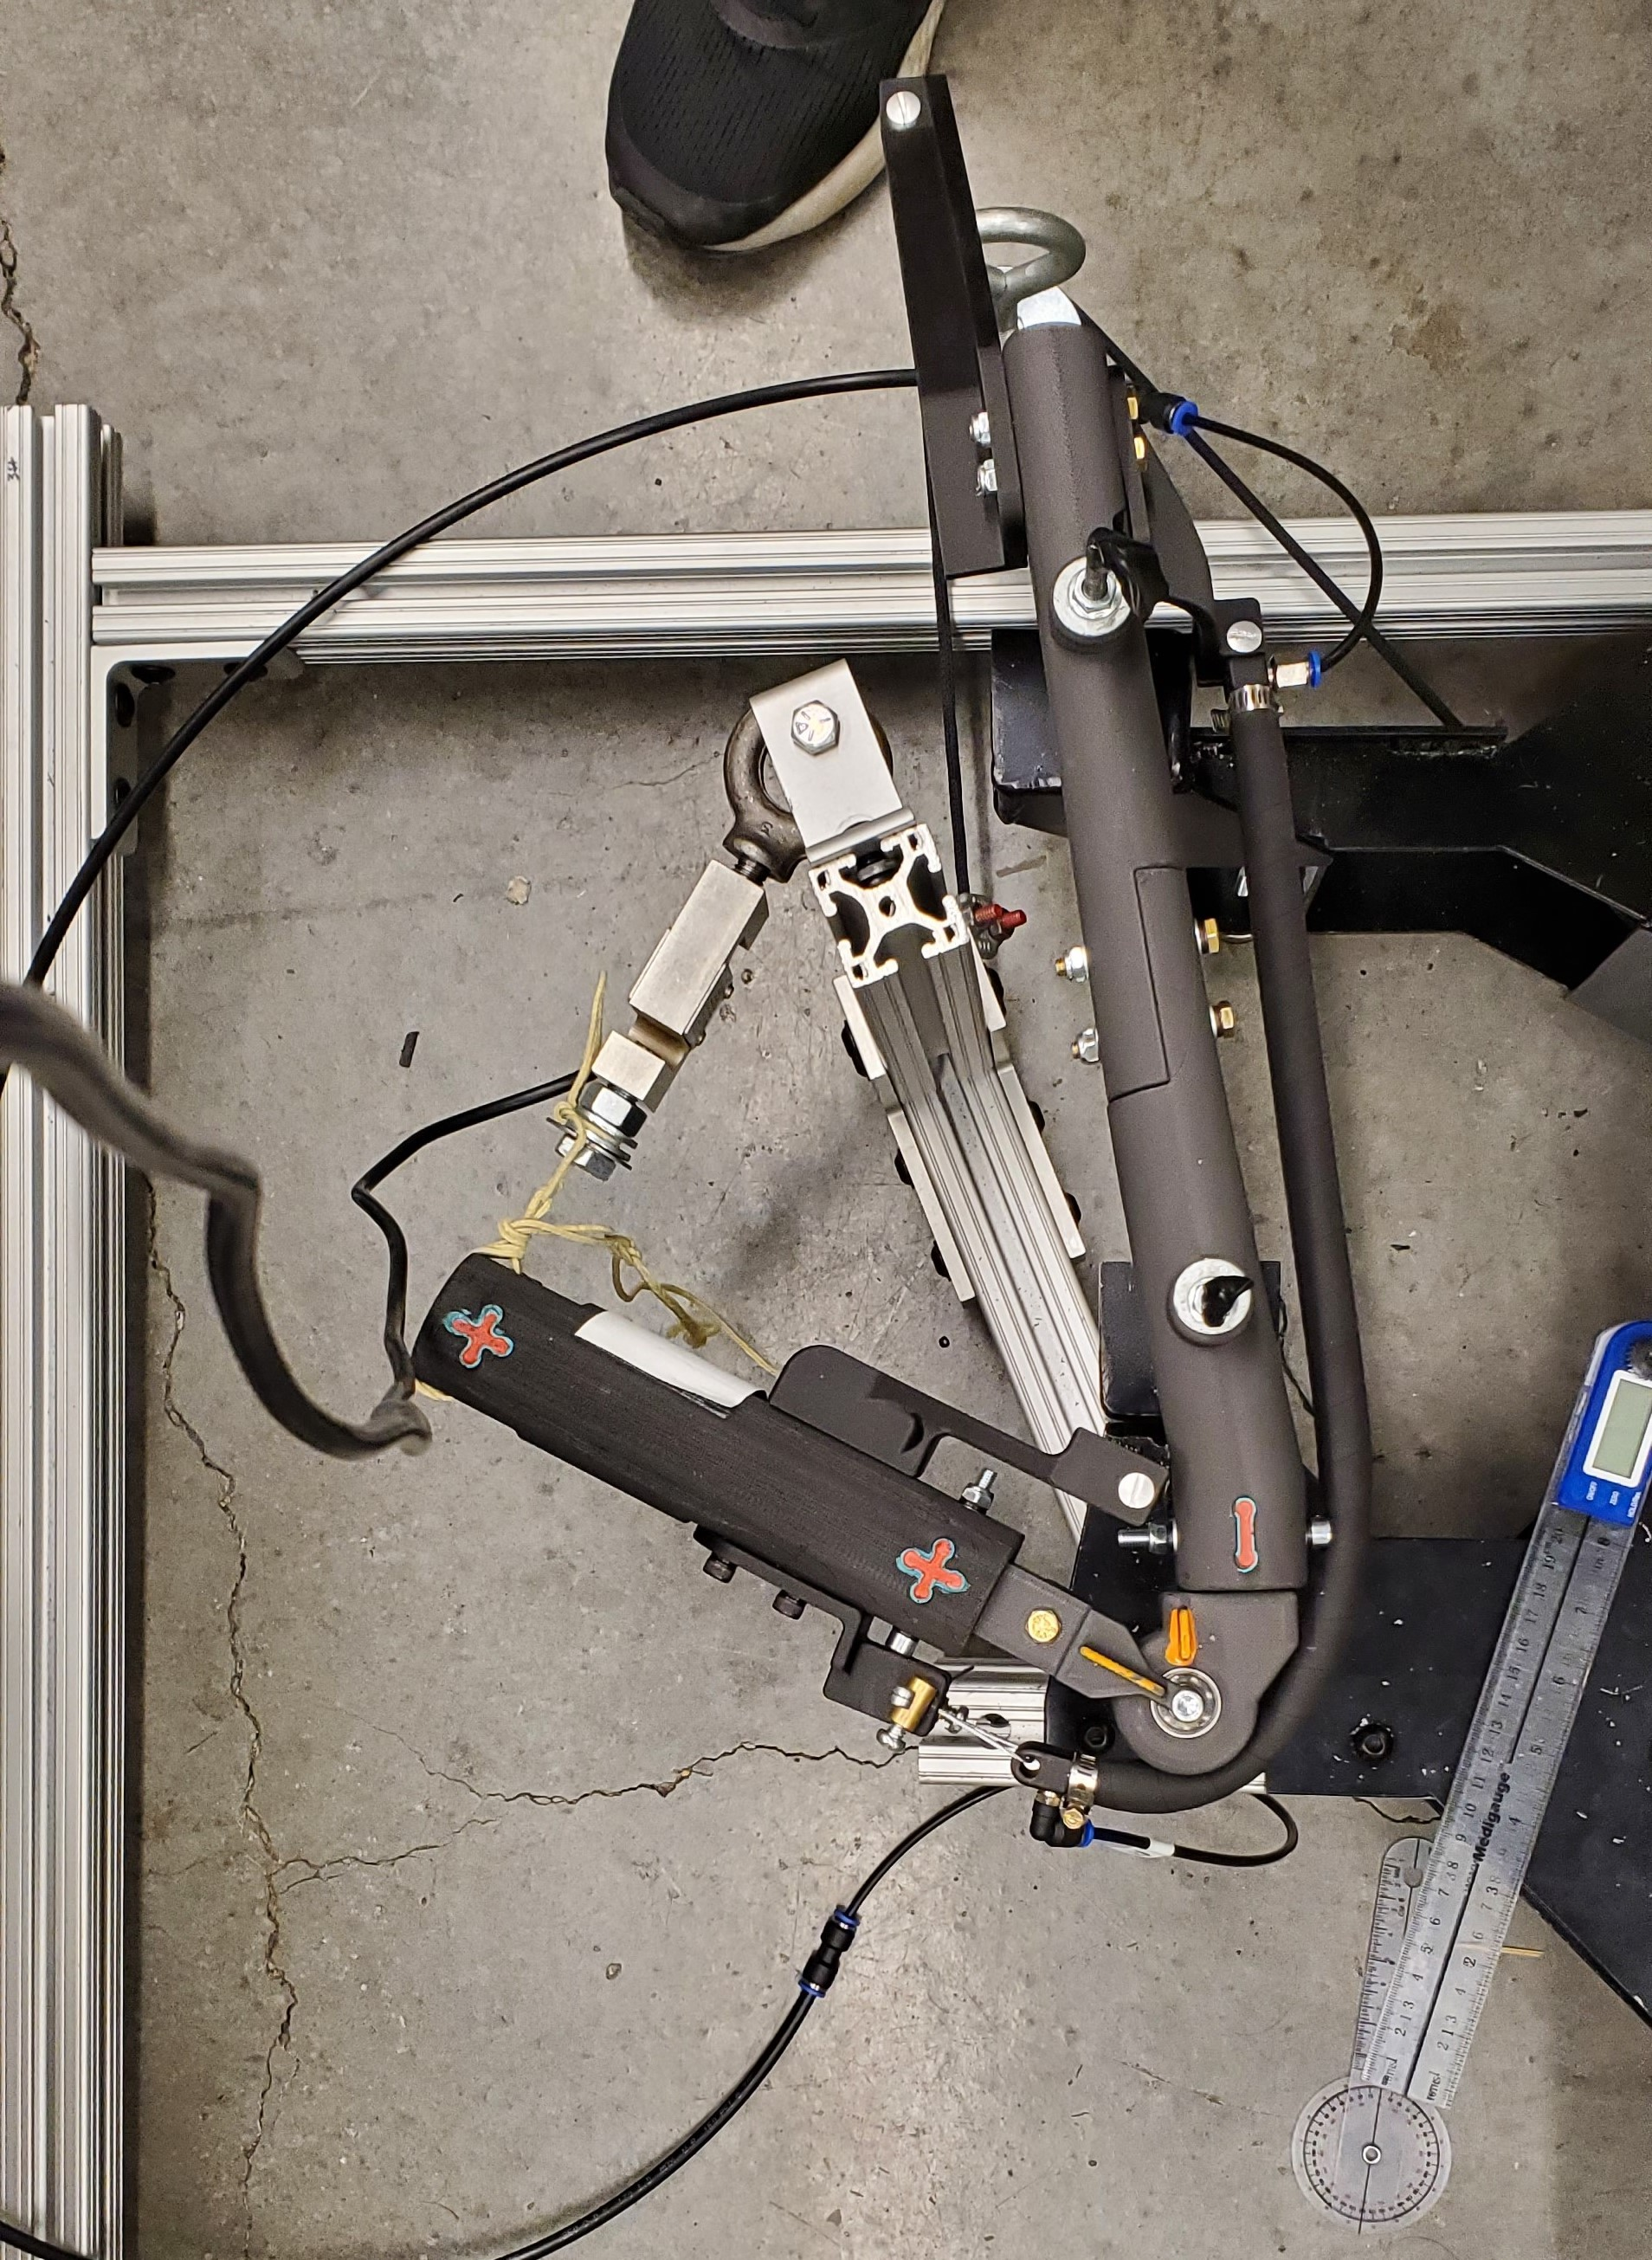
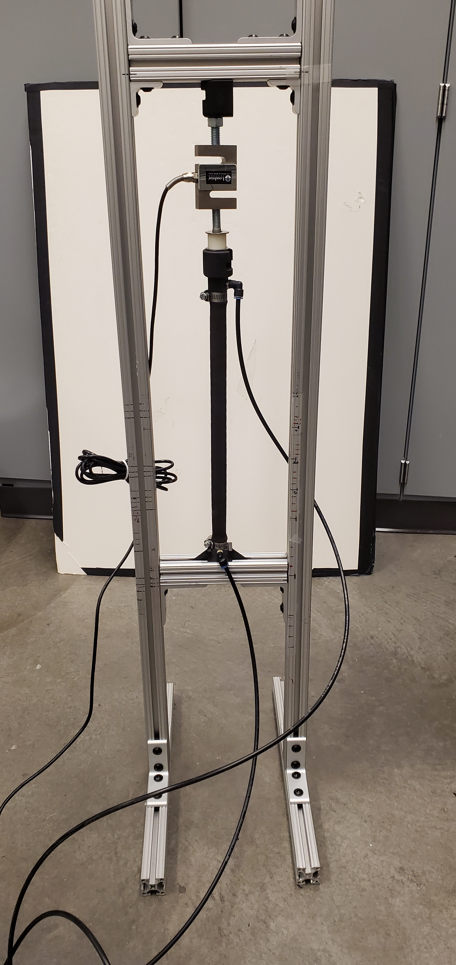
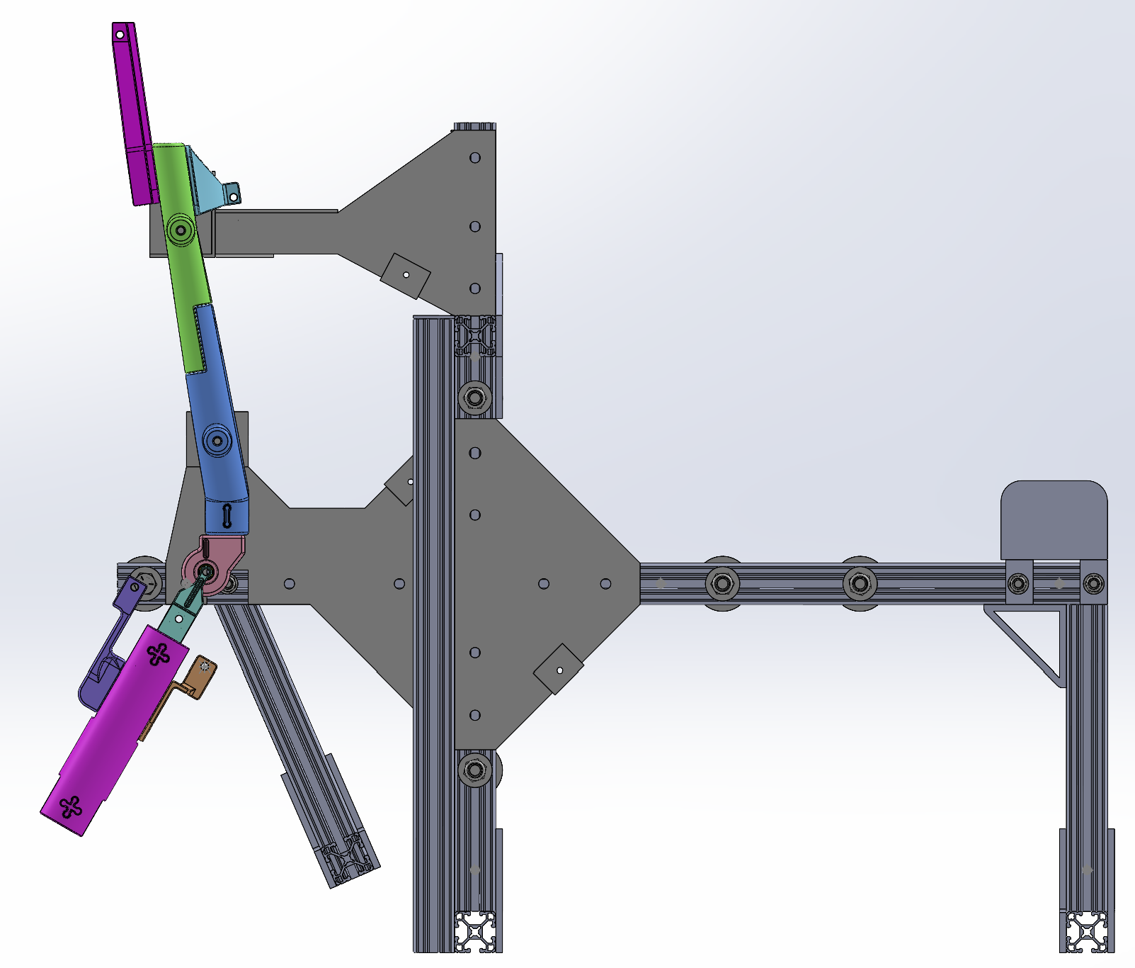
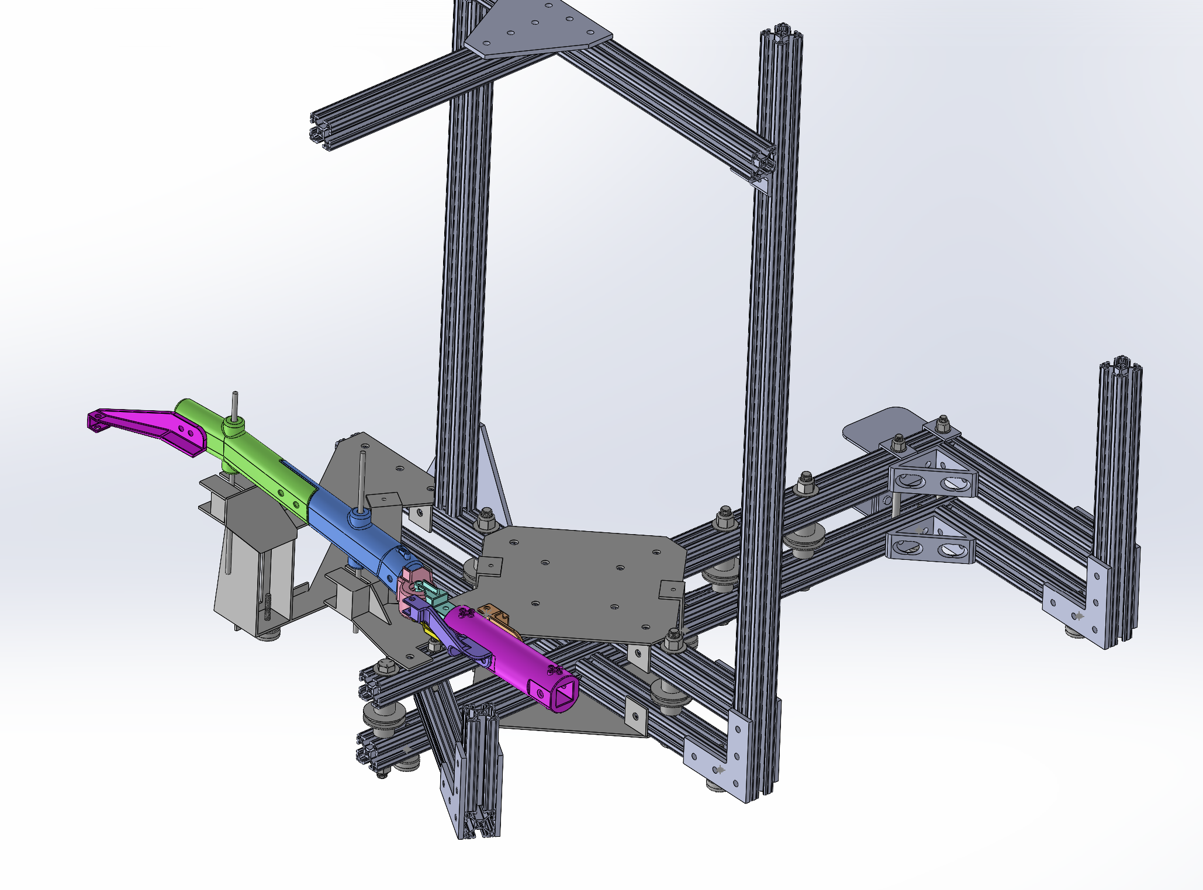
A)
B)
Test Frame
Load Cell
Air supply
End caps
Hose clamps
BPA Length
Air to pressure sensor
C)
Femur
D)
BPA
Test jig assembly
mounting locations
Knee joint
Tibia
θ
Winch housing
Load cell
Winch cable
Swing arm

